Slide 1



Predicting the change in insurance rate post Affordable Care Act - A supervised learning approach
Seán McManus, PhD
Link to live presentation: http://bit.ly/2LXzIQl

Slide 2
Background..

Slide 3
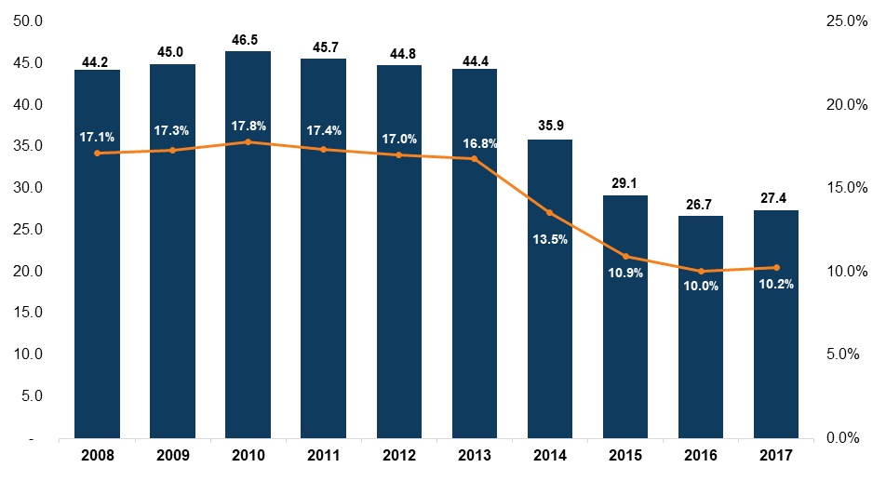
# of uninsured individuals and % uninsured:
Notes:
Decrease of close to 20 million people

Slide 4
Why should we care :
Uninsured cancer patients generally have poorer outcomes and are more likely to die prematurely than persons with insurance, largely because of delayed diagnosis. Results in higher morbidity and higher mortality.
Uninsured adults with chronic diseases are less likely to receive appropriate care to manage their health conditions than are those who have health insurance. Results in higher morbidity and higher mortality.
Uninsured adults with hypertension or high blood cholesterol have diminished access to care - higher morbidity and mortality
Uninsured persons with diabetes are less likely to receive recommended services - higher morbidity and mortality.
Adults with health insurance that covers any mental health treatment are more likely to receive mental health services and care consistent with clinical practice guidelines.
Uninsured patients with acute cardiovascular disease are less likely to be admitted to a hospital - higher morbidity and mortality.

Slide 5

A moral issue….

Slide 6

A fiscal responsibility issue….

Slide 7

The hidden risks….
Contagian of disease
Loss of productivity and contribution to the economy by the worker
Loss of productivity and contribution to the economy due to burden on non-professional family care givers (brother taking care of sister, parent taking care of grown adult = potential loss of two productive tax payers)
The money spent on medicaid expansion has had a multiplier effect estimated at 1.5 to 2 times the investment.
In other words, the money invested in decreasing the percentage of individuals uninsured, is effectively a money maker.
[1]

Slide 8
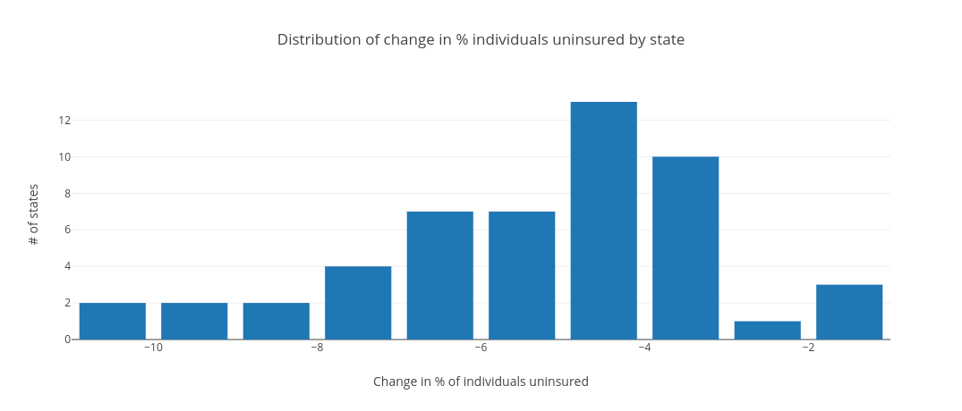
Our problem:
The ACA lead to 20 million people gaining insurance, but the effect of this piece of legislation varied greatly by state.

Slide 9
The question(s):
Can we accurately predict the effect size of the ACA , as measured by change in % individuals uninsured, using feature variables that describe that state?
Can we establish the metrics that have the biggest effect on the change in % individuals uninsured?
The benefits:
Objective benefits:
Potential to inform strategically crafted legislation that maximizes effect size.
Non-objective benefits:
..this is of major political capital.

Slide 10

The data:
Personally collated data set..from data provided by:
Department of Health and Human Services
and
The Henry J Kaiser Family Foundation

Slide 11
The data - described:
Target feature:
Dataframe shape: 52 samples/rows and 34 features
Significant feature engineering and subsequent feature selection
Significant sample size problems
No missing data

Slide 12
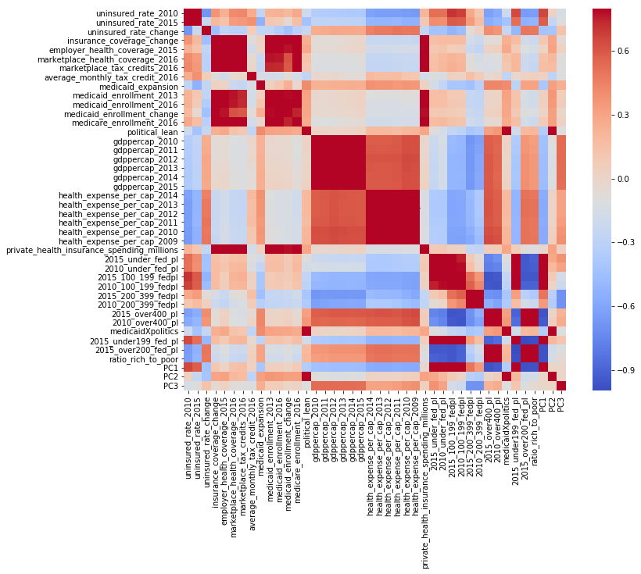
Lot’s of descriptive
value in the features, perhaps not enough samples..

Slide 13
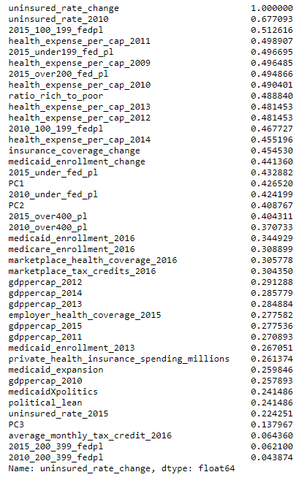
First task: reduce variables
Tried PCA to compress effect of politics and levels of poverty into 1 or 2 variables - ultimately didn’t include these.
Process of elimination led to selection of the following:
Health Expense Per Cap 2012 (wanted 2010 data but was unavailable)
Ratio of individuals over 200% federal poverty line (FPL) to individuals under 200% of FPL
Uninsured Rate 2010
Political Lean
Medicaid Expansion Status

Slide 14
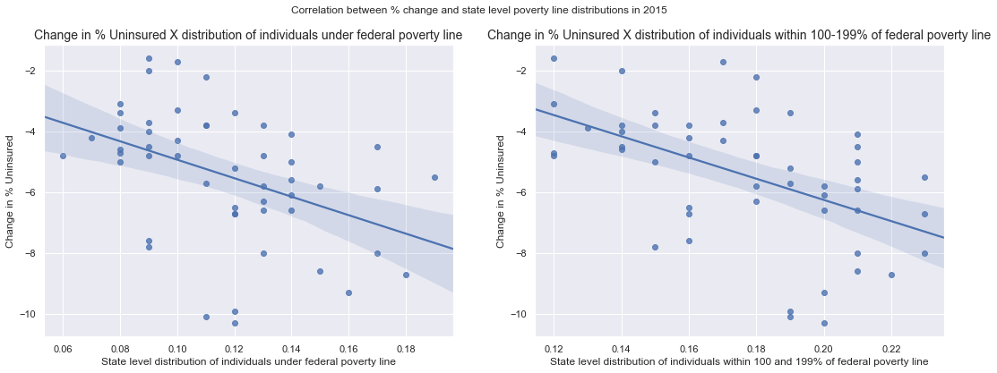
Exploration - effect of poverty levels:

Slide 15
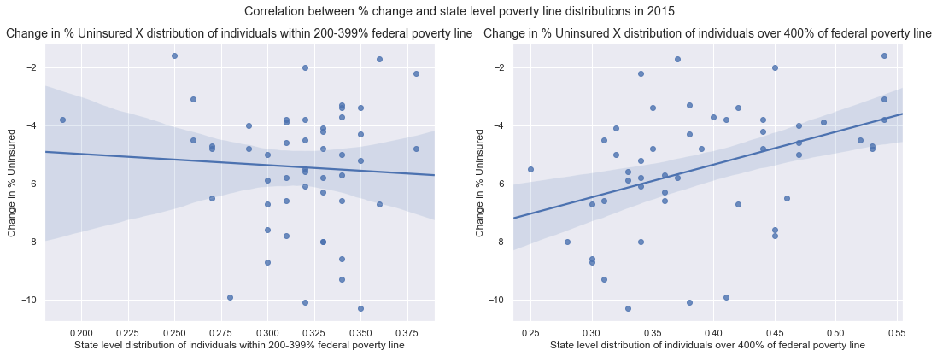
Exploration - effect of poverty levels:

Slide 16
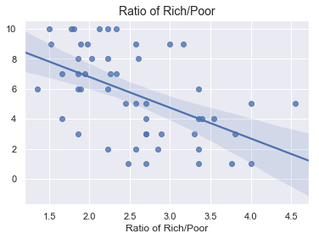
Feature ratio of ‘Rich’ to ‘Poor’ gave best balance of descriptive value and dimensionality.

Slide 17
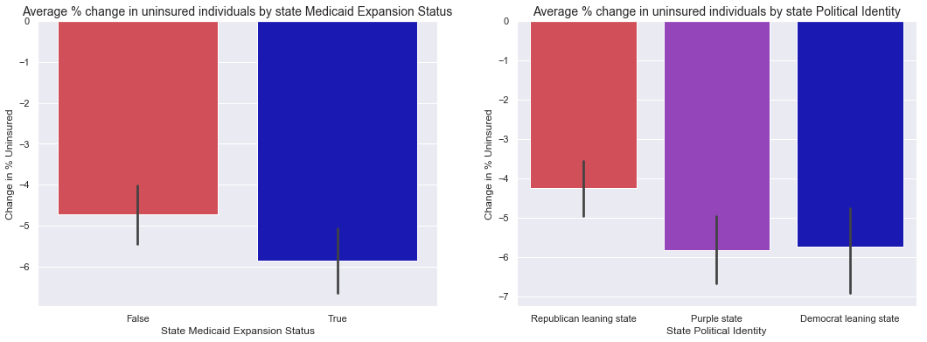
Exploration - Medicaid Expansion X State politics interaction (Pt I)

Slide 18
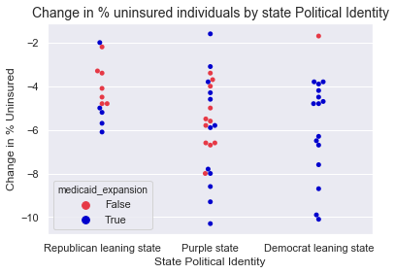
Exploration - Medicaid Expansion X State politics interaction (Pt II)

Slide 19
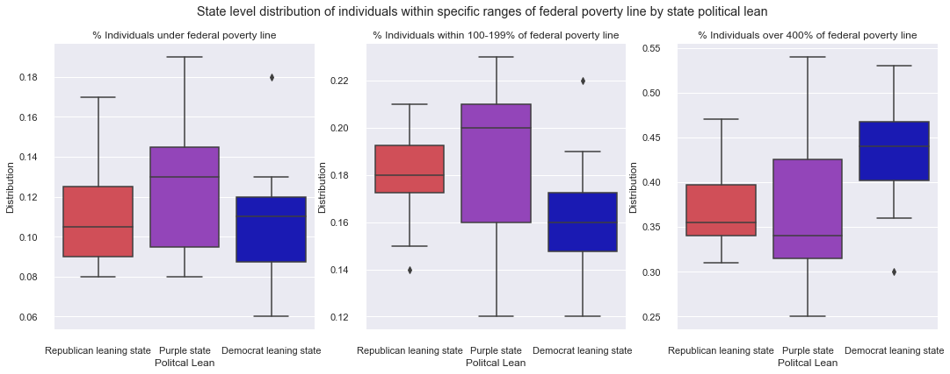
What about when we account for poverty level?

Slide 20
Suggests economics and medicaid expansion offer bulk of predictive power, but political lean flavors these interactions and adds extra predictive power.

Slide 21
Should we include state politics as a feature variable?
This requires justification - it should only be added if it adds predictive value, not to support a partisan stand point.
Both medicaid expansion status and political lean added significant predictivity accuracy to my models that could not be replicated with other variables.
Generally low correlation with other features of the dataset.
TLDR: Politcal lean had an effect that couldn’t be replicated by inclusion of other variables.

Slide 22
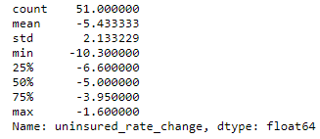
Any issues with our outcome variable?
Slight negative skew.
Otherwise relatively normally distributed.
Data not transformed or modified to preserve integrity of investigation.

Slide 23
The models:
Initial approach:
Initial models utilized all variables
Not efficient, or productive time wise
Subsequent models focussed on my selected variables
Predictive accuracy increased, as to be expected
Tried as both classification and regression problem...regression results presented here..

Slide 24
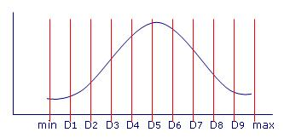
Some models aren’t suited to regression…
Can I make this a classification problem if needed?
Some supervised learning models cannot be adopted towards regression. As an option, I also encoded the data in categories depending on their decile level. Could also look at quintiles, quartiles, etc.
Downside of this approach:
Loss of resolution could mean artificially higher score metrics for these models.
Groups split equally in number but not in effect size bins.

Slide 25
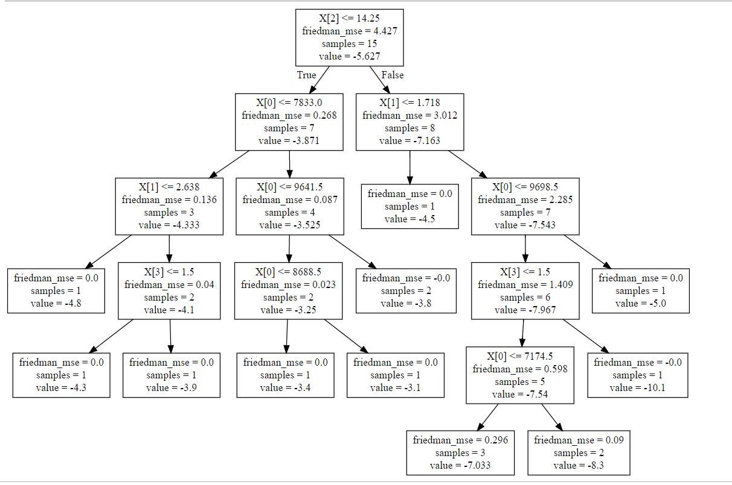
The models - Decision tree regressor:
Decision Trees:
Tried as a classification problem with deciles, not productive. Best score was 0.25
Ran as a regressor with following settings:
Criterion=Friedman MSE Max features=3 Max depth=5 Splitter = best
Optimizes decision tree splits based on Friedmann improvement score on MSE.
In this context, there’s a problem with this.

Slide 26
The models - Decision tree regressor:
Decision Trees:
Regressor with following settings:
Criterion=Friedman MSE Max features=3 Max depth=5 Splitter = best
It’s easy for the computer to get the MSE down and fit the data with this improvement score. We only have 52 samples.
It’s not a generalizable model though.
Results: Training R² = 0.999 Test R² = -0.114 Completely overfit

Slide 27
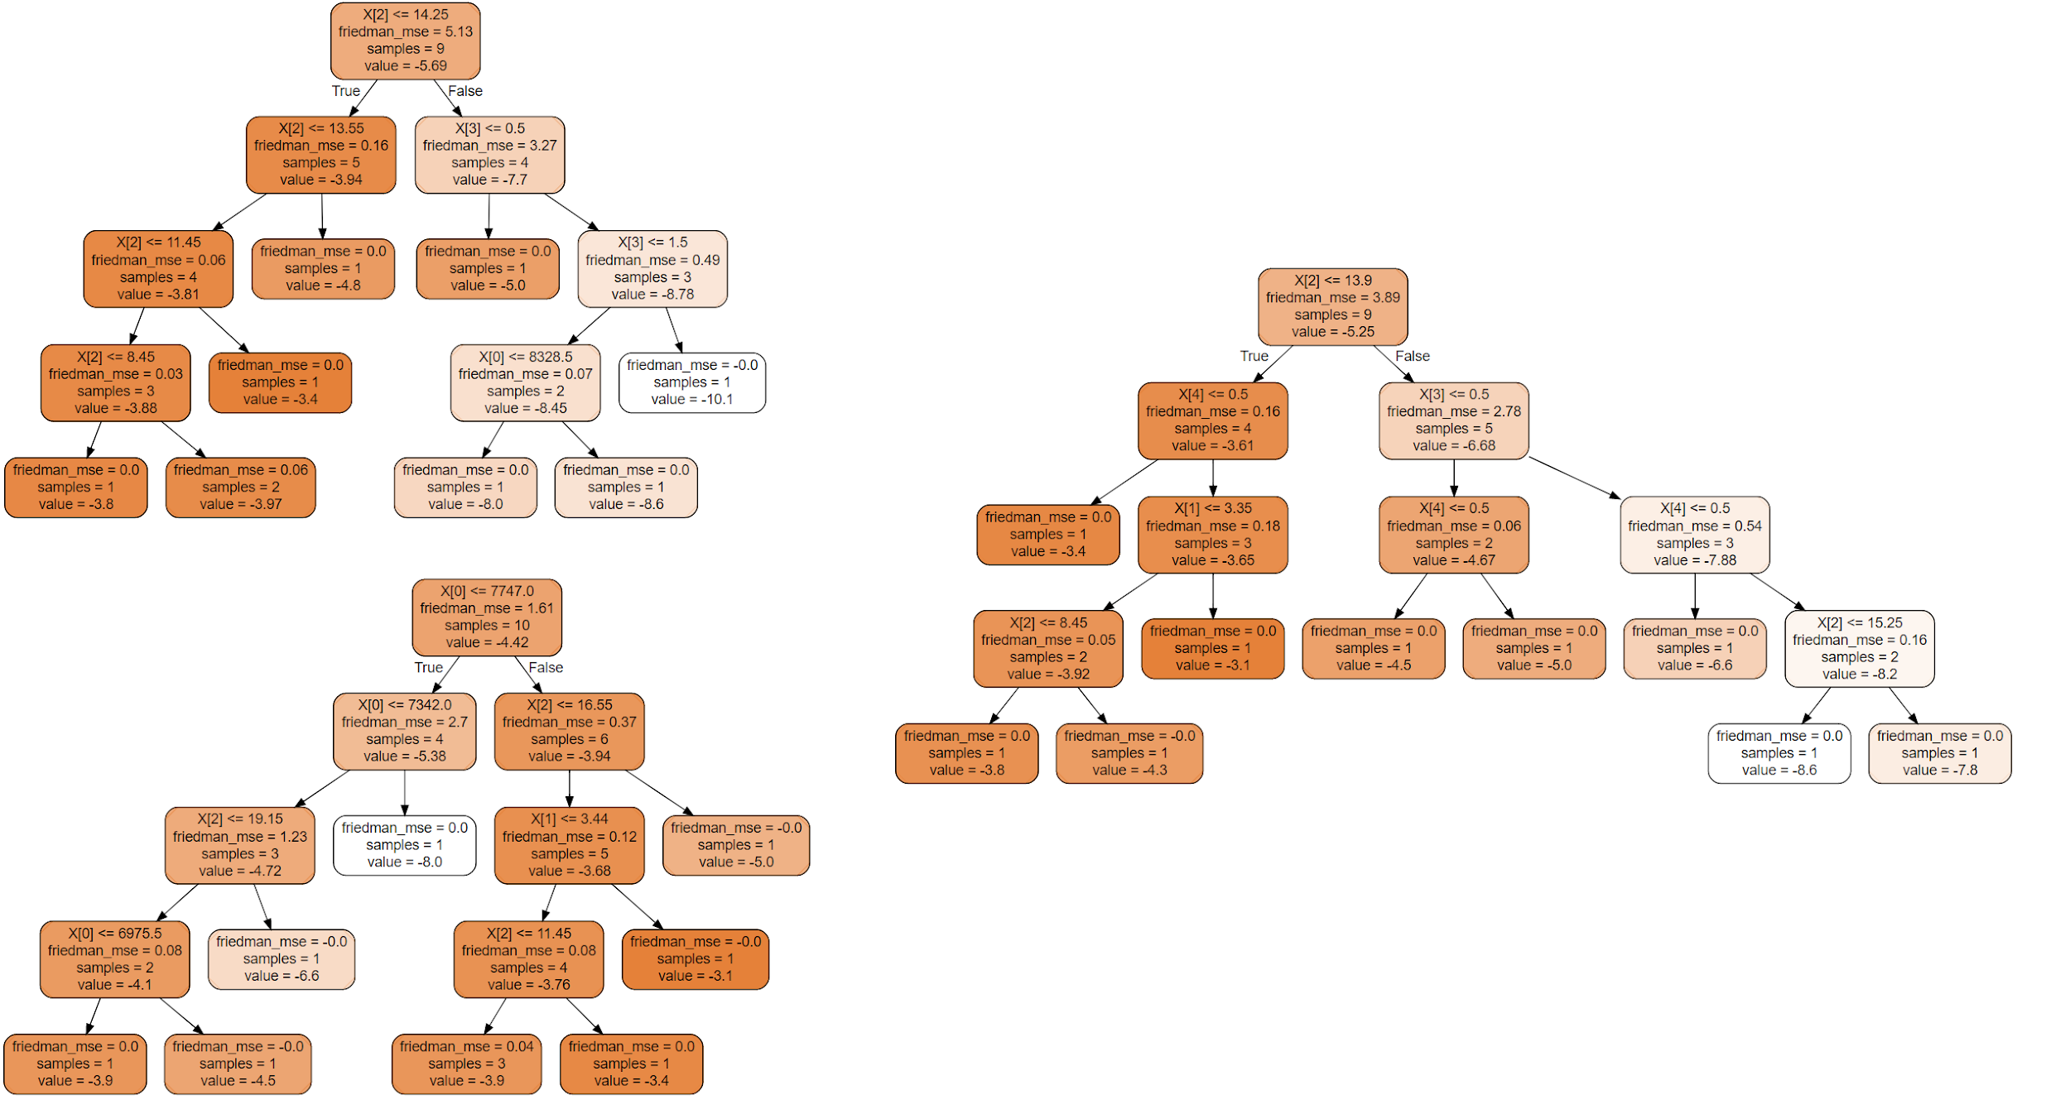
The models - Random Forest:
Some of the trees from my forest.
Grid Search CV yielded similar parameters:
Criterion=Friedman MSE Max features=2 Max depth=4 # of estimators =20
Results: Training R² = 0.638 Test R² = 0.525 Not a completely terrible model - but not still not great

Slide 28
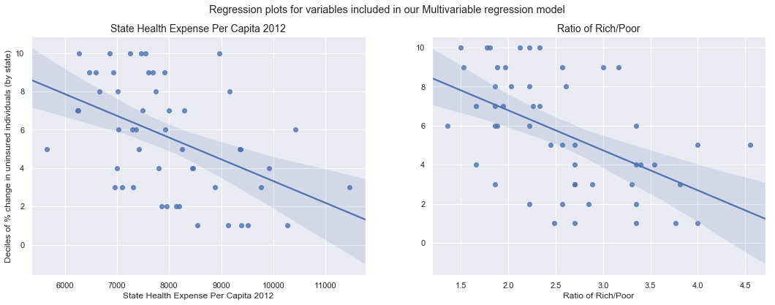
The models - Multivariable Linear Regression:
Sometimes simplest is the best:
Results: Training R² = 0.758 Test R² = 0.702 A good model

Slide 29
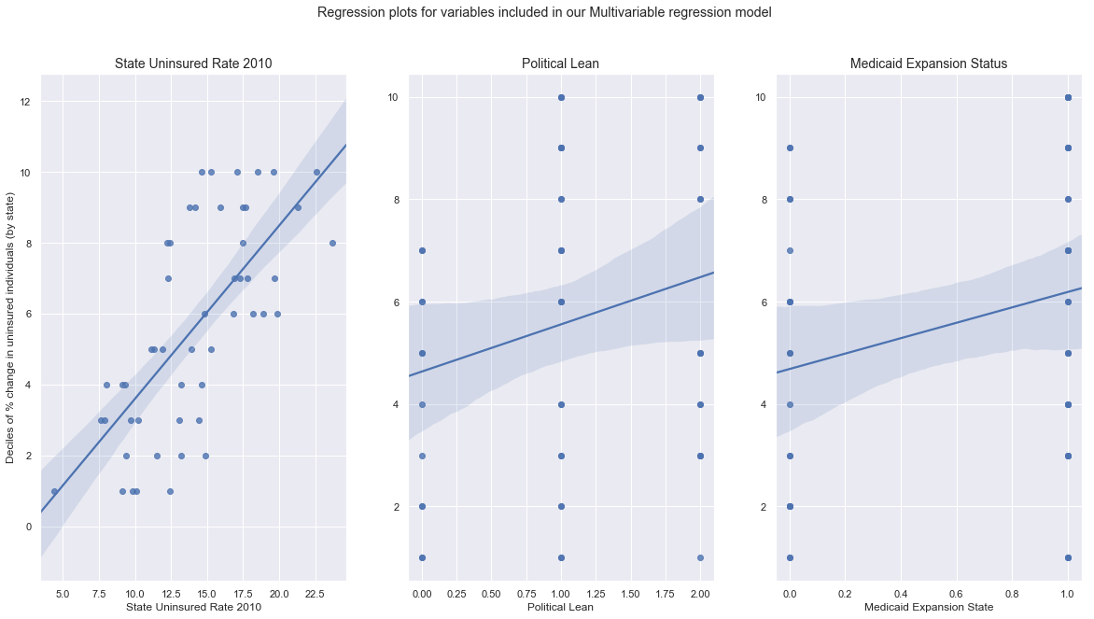
The models - Multivariable Linear Regression:
Sometimes simplest is the best:
Results: Training R² = 0.758 Test R² = 0.702 A good model

Slide 30

The models - Gradient Boost Regression
Grid Search CV yielded the following parameters: Learning rate=0.2 loss=ls Max features=4 # of estimators =8
Results: Training R² = 0.674 Test R² = 0.30 Looks ok initially..but overfit
‘Bringing a gun to a knife fight’

Slide 31
The models - Gradient Boost Regression
Grid Search CV yielded the following parameters: Learning rate=0.2 loss=ls Max features=4 # of estimators =8
Results: Training R² = 0.674 Test R² = 0.30 Looks ok initially..but overfit
‘Bringing a gun to a knife fight’

Slide 32
The models - Gradient Boost Regression
Advantages of boosting methods with linear regression: -Helping in the case of overfitting. (helps too much here..)
-When data is of some non linear complex shape. Boosting allows model to slowly evolve to fit data.
Gradient Boost Regression results: Training R² = 0.674 Test R² = 0.30 Not a good model
Vanilla Multivariate Linear Regression results: Training R² = 0.758 Test R² = 0.702 A good model

Slide 33
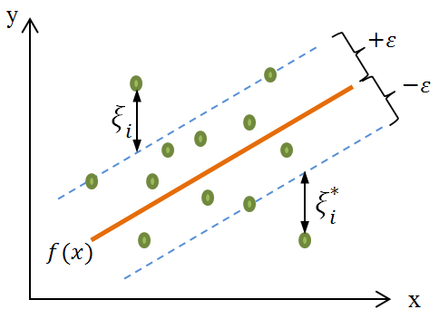
The models - Support Vector Machines
Grid Search CV crashed my kernel, so parameters were tested individually:
C: No impact from changing Episilon: No impact from changing Kernel: RBF or Linear worked equally (poorly)
Support Vector Machines results: Training R² = 0.445 Test R² = 0.608 Underfit - model may be biased towards positive end of tail

Slide 34
The models - my pick:
The multivariable linear regression model has high predictive accuracy AND seems to be generalizable.
Model was not over OR underfit.

Slide 35
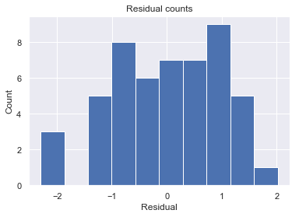
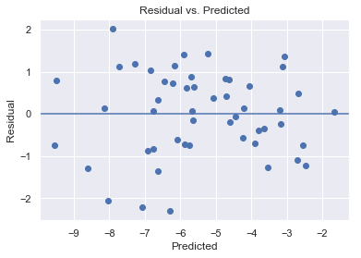
The models - my pick:
- Model prediction shows normal distribution and relative homoscedascity. - Trend for higher residuals for states with higher changes in uninsured rate. - Somewhat to be expected, also may suggest some bias in model - likely due to negative skew of distribution.

Slide 36
What we learned...:
Real world impact (for data scientists):
We can give an estimate on the effect any given state *could have had from the ACA under ideal conditions using our model...
We have a better idea what variables affect the real world impact of legislation like the ACA.
Predictive quality of analysis could be used to craft state specific legislation to reduce effect of externalities on both economic outcomes and human quality of life.
Interested party’s could use this information how they choose...

Slide 37
What we learned...:
Real world impact (translated):
Change in percentage of uninsured individuals as a result of the ACA can be most accurately predicted by the following variables:
The baseline uninsured rate (obvious)
State health expense per capita (greater pressure to adopt health care coverage)
Ratio of individuals below 200% of FPL to above 200% of FPL (various reasons)
State Political Lean
Medicaid Expansion Status

Slide 38
What we learned...:
My own learning:
- Start with simpler models and then build up - Start with fewer higher impact variables and then build up not vice versa. - Sometimes complex problems have simple answers - you just need to know how to look for them

Slide 39
What’s next..
To address the short comings of this model a number of steps could be taken:
Small sample size - 2 answers to this problem:
change the way the data is sampled, maybe sample towns instead of states (downside: resource/capital intensive)
Use synthetic data generation (although this is often put foward as an answer to class imbalance, it also has the potential to introduce bias..)
The higher residuals for those states with higher % changes - needs to be further explored. Perhaps there is potential to improve this model with further tinkering to feature selection.
Analysis may have some utility to individuals in public health policy - plan to simplify presentation and circulate to potential end users.

Slide 40
Thank you:
Dr. David Reed, My mentor
Mike Ricos, Reviewer
You, The audience

Slide 41
References
https://www.healthaffairs.org/do/10.1377/hblog20160321.054035/full/

Slide 42
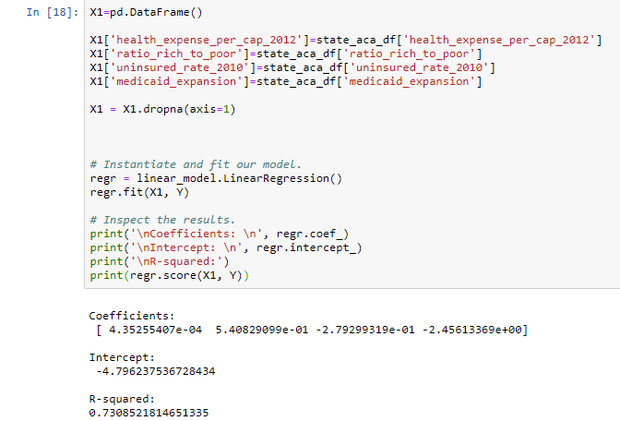
Removing political lean….
Based on comparison of models, effect of political lean is estimated is estimated at minimum of 7-8% of total model.

Slide 43
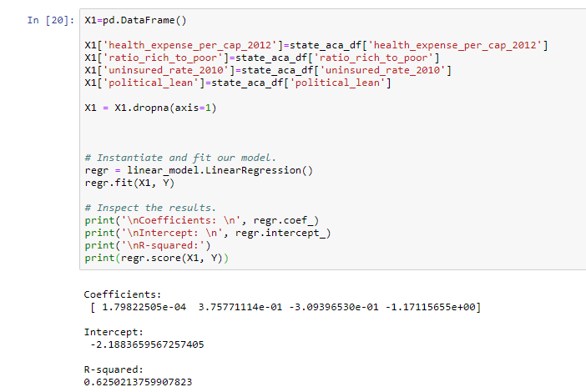
Removing Medicaid Expansion status...
Based on comparison of models, effect of Medicaid Expansion status is estimated is estimated at about 17% of total model

Slide 44
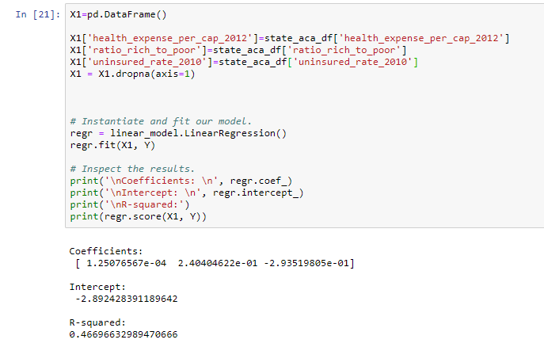
Removing Medicaid Expansion and political lean status...
Based on comparison of models, effect of political lean and medicaid status combined is about 41% of model.
Takehome -> inclusion of one of these features in the model makes up to a large degree for exclusion of another -> some covariance
Medicaid Expansion status played a bigger role in model, interpret causality and/or correlation of these effects as you may....

